Slide 1
Digital Citizenship and Media Literacy
Dr. Larry Magid, Ed.D
Co-director
ConnectSafely.org
Founder
SafeKids.com
Technology Analyst
CBS News

Slide 2
4 Types of Online Safety
Physical safety – freedom from physical harm
Psychological safety – freedom from cruelty, harassment, and exposure to potentially disturbing material
Reputational and legal safety – freedom from unwanted social, academic, professional, and legal consequences that could affect you for a lifetime
Identity, property, and community safety – freedom from theft of identity & property
Source: Anne Collier. NetFamilyNews & ConnectSafely.org

Slide 3
The ‘Net effect’
For the most part, the online world is pretty much like the “real world,” but there are a few special things to think about
It can be permanent
Stuff can be copied and pasted
Lots of people can see it
You don’t know for sure who’s seeing it
AND
Disinhibition: Lack of visual cues reduces empathy
Source: adapted from danah boyd: Taken out of Context, 2008

Slide 4
What adults worry about
Stranger danger
Viewing inappropriate content
Posting/sending inappropriate content
Cyberbullying & harassment
Privacy and reputation
Online addiction
Online contributing to destructive, illegal or inappropriate behavior
Device security & social engineering

Slide 5
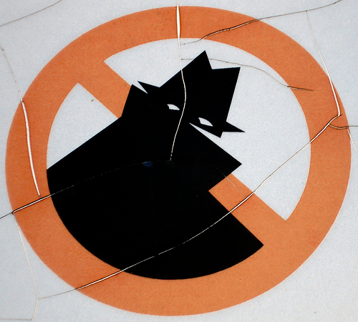
“Stranger danger”

Slide 6
Who are you talking to?
Most people on and off the Web are nice folks, but not everyone
People may not be who they say they are
If the conversation turns to sex or starts to get creepy, get out of there
Never meet up with someone you first met online
But if you must, take along a parent or a bunch of your friends and make sure it’s in a public place and let people know where you’re going

Slide 7
Digital citizenship

Slide 8
What it means to be a digital citizen
You have rights and responsibilities
Other people have rights too
Treat others the way you want to be treated
Be nice to friends online and off line
Respect other people’s privacy
Your online life is a reflection of you
Respect other people’s digital property
Respect other people’s digital space (don’t be a hacker)
Insist that you and people around you be treated respectfully

Slide 9
Strut your own stuff
Stuff you create belongs to you and you should control what’s done with it
Don’t steal other people’s digital material
Just because you can’t hold it in your hand doesn’t mean it’s not real
Be original
It’s OK to quote others but their words are their words
Cite your sources
Whether it’s a quote or a picture, show where you got it. It actually makes you look smarter

Slide 10
Digital literacy
Image:Texas Dept. of Criminal Justice

Slide 11
Passwords
Protect your passwords
Don’t even share them with your best friends
Create secure passwords
Use a phrase that’s easy to remember but hard to guess
Use symbols and numbers
Don’t use the same password on multiple sites

Slide 12
Security
Use security software
Keep your operating system and programs up-to-date
Be careful about WiFi hotspots
Avoid dangerous websites with “drive-by downloads”
Don’t download anything from a source you don’t trust
Back up your data

Slide 13
Privacy & Reputation Management

Slide 14
Protect your privacy
It’s up to you to control what other people know about you
If it’s private, don’t post it online – not even via email
Anything can be copied, pasted and forwarded
Once it’s posted, you can’t take it back

Slide 15
Reputation management: Have a good digital footprint
A online reputation is better than none at all
One of the best ways to bury embarrassing search results is to create good ones

Slide 16
Critical thinking
Not everything you see online is true
Consider the “source” and only rely on information from trusted sources
Not all sites have your best interest in mind
Self harm & substance abuse
Hate & harassment
Just because someone is an adult, doesn’t mean they’re necessarily a good role model
Look at the URL to make sure you are where you think you are

Slide 17
Social networking
Learn to use the privacy tools
Don’t post stuff that will get you in trouble now or in the future
Be honest about your age
There are good reasons that they ask what year you were born
Tag responsibly

Slide 18
“Sexting”
It could be against the law
It could haunt you later on
Don’t take the picutres
Don’t send them – even to someone you really care about
If you get them, don’t share them
Don’t carry them around on your phone. You could be breaking the law

Slide 19
Reporting abuse
Get to know the service’s reporting tools
Consider “social reporting”
Sometimes just asking the person to take something down is all that’s necessary
Talk with trusted adults and kids

Slide 20
Don’t go there
There are certain places on the net you shouldn’t go. You know what I mean

Slide 21
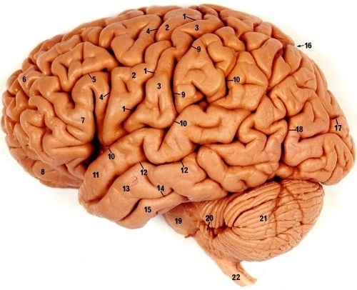
Use the computer between your ears
Protection that lasts a lifetime
Training wheels for young kids

Slide 22
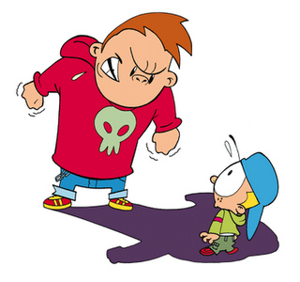
Cyberbullying

Slide 23
Bullying has been around for a very long time, but cyberbullying…
Bullies can be invisible: (Victims sometimes do not know who the bully is, or why they are being targeted)
Viral: (Hurtful actions of a cyberbully are viral; that is, a large number of people (at school, in the neighborhood, in the city, in the world!) can be involved in a cyber-attack on a victim, or at least find out about the incident… The perception is that absolutely everyone is in on the joke.
Easy: Often easier to be cruel using technology because cyberbullying can be done from a physically distant location, and the bully doesn’t have to see the immediate response by the target
Source: Overview of Cyberbullying (Hinduja and Patchin – cyberbullying.us

Slide 24
Cyberbullying
Flaming
Harassment
Denigration
Impersonation
Outing
Trickery
Exclusion
Cyberstalking
Source: Nancy Willard, Center for Safe & Responsible Use of the Internet

Slide 25
Cyberbullying: Getting Specific
Weird or threatening look Whispering Excluding Blackmailing Spreading rumors Threatening Stealing friends Damaging social relationships Breaking secrets Criticizing clothes & personalities
Source: Robyn Treyvaud: Cyber Safe Kids

Slide 26
What Kids Should Do
Don't respond
Don't retaliate
Talk to some you trust
Adults and peers too
Save the evidence
Block the person who is bullying you
Be civil
Don't be a bully
Be a friend, not a bystander

Slide 27
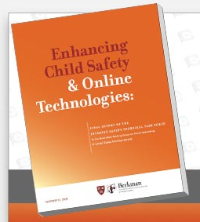
What goes around comes around
“Youth who engage in online aggressive behavior by making rude or nasty comments or frequently embarrassing others are more than twice as likely to report online interpersonal victimization."
Notes:
THIS WAS A REVELATION TO ME BACK IN 2007, when I first read it in the medical journal, ARCHIVES OF PEDIATRICS & ADOLESCENT MEDICINE.
This is when I realized what a big risk factor young people’s own behavior is – in the contexts of both bullying and predation.
HERE’S THE CHART.... [next slide]
http://archpedi.ama-assn.org/cgi/content/full/161/2/138
[See also: “Digital risk, digital citizenship” <http://www.netfamilynews.org/2009/05/digital-risk-digital-citizenship.html>.]

Slide 28
Cyberbullying Panic!
“85% of 12 and 13 year-olds have had experience with cyberbullying,” according to one claim

Slide 29
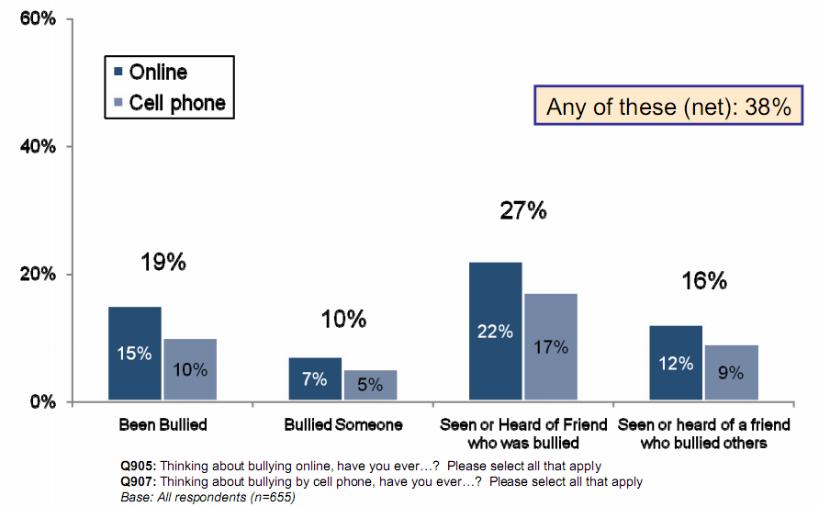
Most kids don’t bully
Source: Cox Communications Teen Online & Wireless Safety Survey

Slide 30
Examples of positive norming
Source: Assessing Bullying in New Jersey Secondary Schools: Applying the Social Norms Model to Adolescent Violence: Craig, Perkins 2008

Slide 31
Cornerstones of Online Safety 3.0
Media literacy / Critical thinking
Digital citizenship

Slide 32
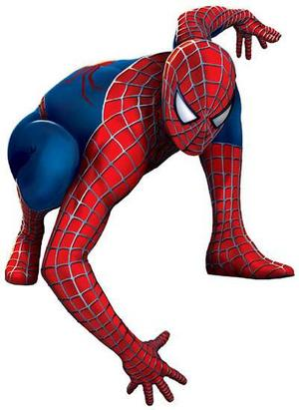
Advice to Youth
“With great power comes great responsibility”
-Ben Parker, Spiderman
Image ©2007 Marvel Characters

Slide 33
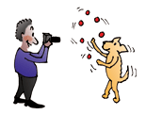
Thank you!
Larry Magid
larry@connectsafely.org
Notes:
33

